Slide 1

Learning Objectives
LO1 Define what a journal is and explain why it is used to record transactions.
LO2 Compare and contrast different types of source documents.
LO3 Identify the four parts of a journal entry.
© 2014 Cengage Learning. All Rights Reserved.

Slide 2
Journals and Journalizing
Lesson 3-1
LO1
A form for recording transactions in chronological order is called a journal.
Recording transactions in a journal is called journalizing.

Slide 3
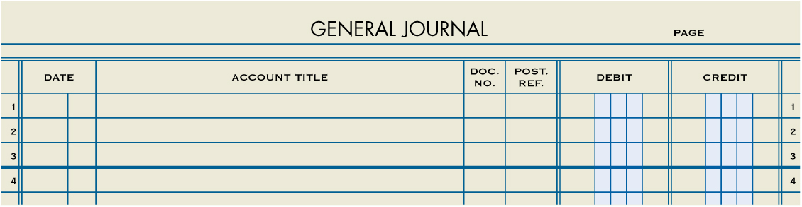
General Journal
Lesson 3-1
LO1

Slide 4
A General Journal
Lesson 3-1
LO1
Accuracy
Chronological record
Double-entry accounting
Information for each transaction recorded in a journal is called an entry.
The recording of debit and credit parts of a transaction is called double-entry accounting.

Slide 5
Source Documents
Lesson 3-1
LO2
A business paper from which information is obtained for a journal entry is called a source document.

Slide 6
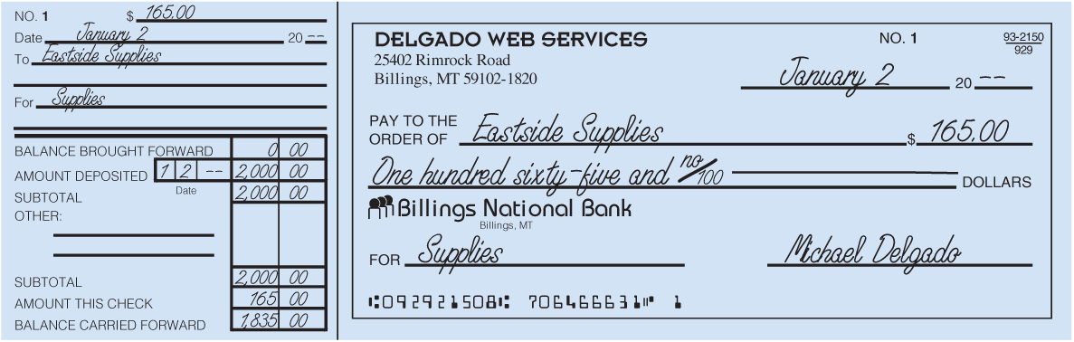
Checks
Lesson 3-1
LO2
A business form ordering a bank to pay cash from a bank account is called a check.

Slide 7
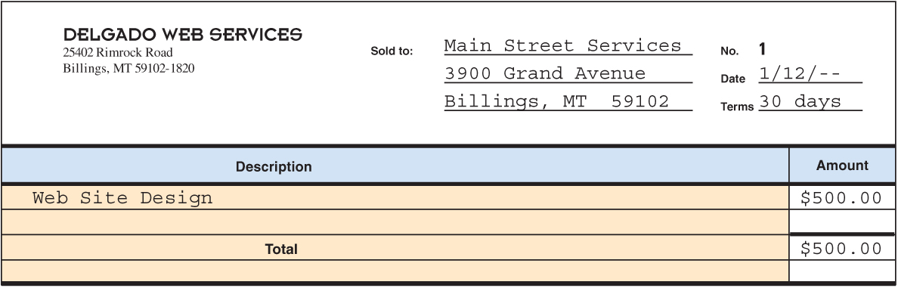
Invoice
Lesson 3-1
LO2
A form describing the goods or services sold, the quantity, the price, and the terms of sale is called an invoice.

Slide 8
Sales Invoice
Lesson 3-1
LO2
An invoice used as a source document for recording a sale on account is called a sales invoice.
A sales invoice is also referred to as a sales ticket or a sales slip.

Slide 9
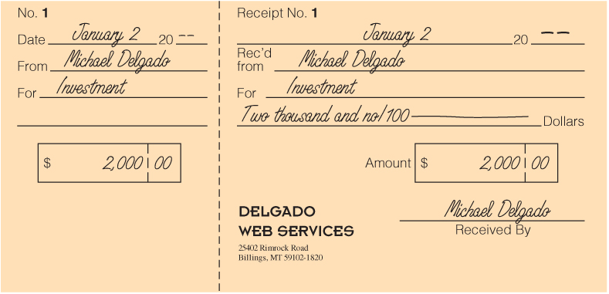
Receipt
Lesson 3-1
LO2
A business form giving written acknowledgement for cash received is called a receipt.

Slide 10
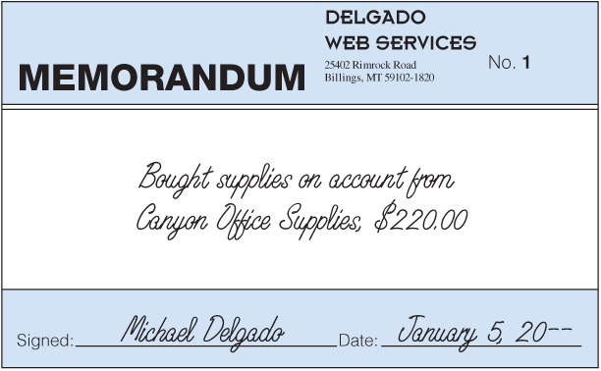
Memorandums
Lesson 3-1
LO2
A form on which a brief message is written to describe a transaction is called a memorandum.

Slide 11
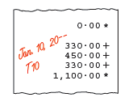
Calculator Tapes
Lesson 3-1
LO2

Slide 12
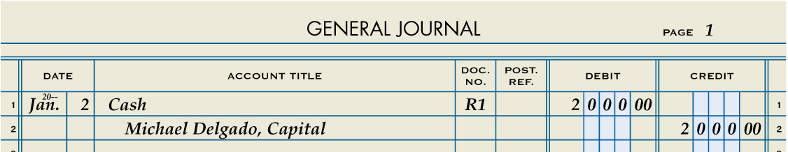
Received Cash from Owner as an Investment
Lesson 3-1
LO3
Cash
January 2. Received cash from owner as an investment, $2,000.00. Receipt No. 1.
2,000.00
Michael Delgado, Capital
1
Date
2
Debit
Source Document
2,000.00
4
3
Credit
1. Write the date in the Date column.
2. Write the title of the account debited in the Account Title column. Write the debit amount in the Debit column.
3. On the next line, indented about one centimeter, write the title of the account credited in the Account Title column. Write the credit amount in the Credit column.
4. Write the source document number in the Doc. No. column.

Slide 13
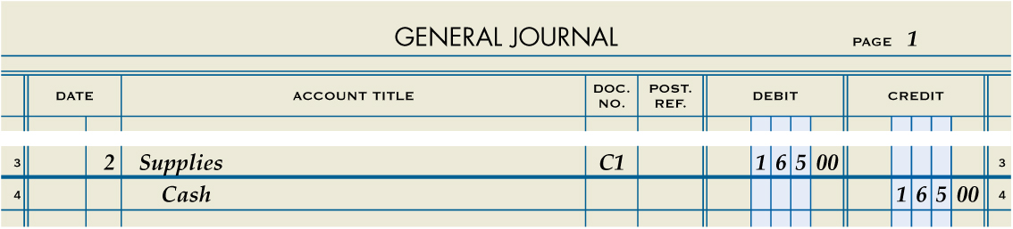
Paid Cash for Supplies
Lesson 3-1
LO3
Supplies
January 2. Paid cash for supplies, $165.00. Check No. 1.
165.00
Cash
165.00
1
Date
2
Debit
Source Document
4
3
Credit
1. Write the date in the Date column.
2. Write the title of the account debited in the Account Title column. Write the debit amount in the Debit column.
3. On the next line, indented about one centimeter, write the title of the account credited in the Account Title column. Write the credit amount in the Credit column.
4. Write the source document number in the Doc. No. column.

Slide 14

Lesson 3-1 Audit Your Understanding
Lesson 3-1
1. In what order are transactions recorded in a journal?
ANSWER
By date

Slide 15
Lesson 3-1 Audit Your Understanding
Lesson 3-1
2. Why are source documents important?
ANSWER
Source documents are one way to verify the accuracy of a specific journal entry.

Slide 16
Lesson 3-1 Audit Your Understanding
Lesson 3-1
3. List the four parts of a journal entry.
ANSWER
Date
Debit
Credit
Source document

Slide 17
work together 3-1
Create 2 new general journals using the journal paper.
Journalize the following transactions – use a pencil
Keep these journals – you will use in lesson 3-2

Slide 18
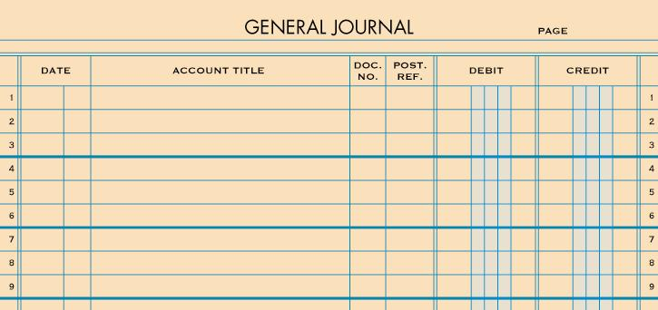
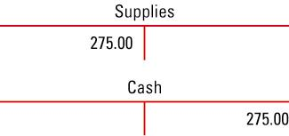
work together 3-1
Apr. 1 Received cash from owner as investment, $2,800.00 Receipt #1.
2
2
Apr
1
Cash
R1
2 8 0 0 00
1
Norma Dirks Capital
2 8 0 0 00
4
3
3
1. Write the date in the Date column.
Cash
2. Write the title of the account debited. Write the debit amount.
2800.00
3. Write the title of the account credited. Write the credit amount.
Norma Dirks, Capital
2800.00
4. Write the source document number in the Doc. No. column.

Slide 19
work together 3-1
Apr. 2 Paid cash for supplies, $415.00. Check #1
2
2
2
Supplies
C1
4 1 5 00
1
Cash
4
4 1 5 00
3
3
1. Write the date in the Date column.
Supplies
2. Write the title of the account debited. Write the debit amount.
415.00
3. Write the title of the account credited. Write the credit amount.
Cash
415.00
4. Write the source document number in the Doc. No. column.

Slide 20
on your own 3-1 Use a new general journal page Complete and check in class
June 2 Received cash from owner as investment, $3,200.00 Receipt #1.
2
2
Jun
2
Cash
R1
3 2 0 0 00
1
Michelle Sullivan, Capital
3 2 0 0 00
4
3
3
1. Write the date in the Date column.
Cash
2. Write the title of the account debited. Write the debit amount.
3200.00
3. Write the title of the account credited. Write the credit amount.
Michelle Sullivan, Capital
3200.00
4. Write the source document number in the Doc. No. column.

Slide 21
on your own 3-1
June 3 Paid cash for supplies, $600.00. Check #1.
2
2
3
Supplies
C1
6 0 0 00
1
Cash
4
6 0 0 00
3
3
1. Write the date in the Date column.
Supplies
2. Write the title of the account debited. Write the debit amount.
600.00
3. Write the title of the account credited. Write the credit amount.
Cash
600.00
4. Write the source document number in the Doc. No. column.

Slide 22

Learning Objectives
LO4 Analyze and record cash transactions using source documents.
LO5 Analyze and record transactions for buying and paying on account.
© 2014 Cengage Learning. All Rights Reserved.

Slide 23
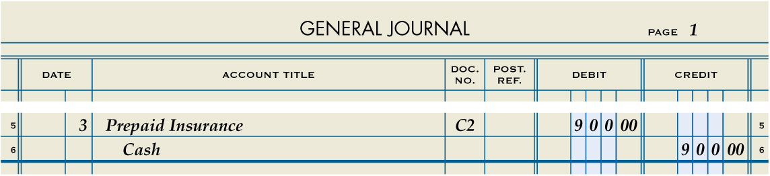
Paid Cash for Insurance
Lesson 3-2
LO4
Prepaid Insurance
January 3. Paid cash for insurance, $900.00. Check No. 2.
900.00
Cash
1
Date
2
Debit
Source Document
900.00
4
3
Credit
1. Write the date in the Date column.
2. Write the title of the account debited in the Account Title column. Write the debit amount in the Debit column.
3. On the next line, indented about one centimeter, write the title of the account credited in the Account Title column. Write the credit amount in the Credit column.
4. Write the source document number in the Doc. No. column.

Slide 24
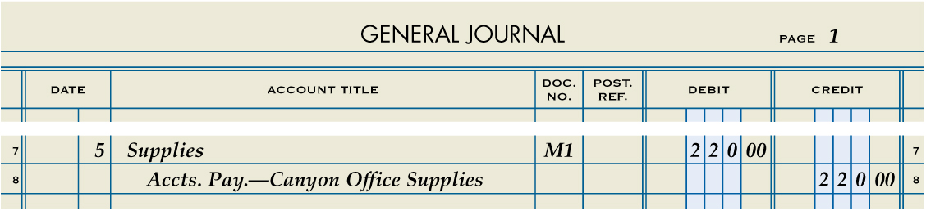
Bought Supplies on Account
Lesson 3-2
LO5
Supplies
January 5. Bought supplies on account from Canyon Office Supplies, $220.00. Memorandum No. 1.
220.00
Accounts Payable—Canyon Office Supplies
220.00
1
Date
2
Debit
Source Document
4
3
Credit
1. Write the date in the Date column.
2. Write the title of the account debited in the Account Title column. Write the debit amount in the Debit column.
3. On the next line, indented about one centimeter, write the title of the account credited in the Account Title column. Write the credit amount in the Credit column.
4. Write the source document number in the Doc. No. column.

Slide 25
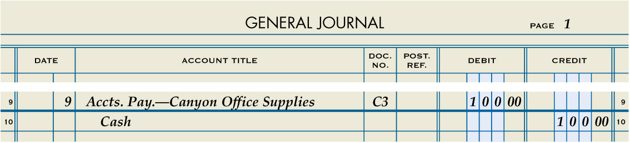
Paid Cash on Account
Lesson 3-2
LO5
January 9. Paid cash on account to Canyon Office Supplies, $100.00. Check No. 3.
Accounts Payable—Canyon Office Supplies
100.00
Cash
100.00
1
Date
2
Debit
4
Source Document
3
Credit
1. Write the date in the Date column.
2. Write the abbreviated title of the account debited in the Account Title column. Write the debit amount in the Debit column.
3. On the next line, indented about one centimeter, write the title of the account credited in the Account Title column. Write the credit amount in the Credit column.
4. Write the source document number in the Doc. No. column.

Slide 26
Lesson 3-2 Audit Your Understanding
Lesson 3-2
1. When cash is paid for insurance, which account is listed on the first line of the entry?
ANSWER
Prepaid Insurance

Slide 27
Lesson 3-2 Audit Your Understanding
Lesson 3-2
2. When supplies are bought on account, which account is listed on the first line of the entry?
ANSWER
Supplies

Slide 28
Lesson 3-2 Audit Your Understanding
Lesson 3-2
3. When supplies are bought on account, which account is listed on the second line of the entry?
ANSWER
Accounts Payable

Slide 29
Lesson 3-2 Audit Your Understanding
Lesson 3-2
4. When cash is paid on account, which account is listed on the second line of the entry?
ANSWER
Cash

Slide 30
work together 3-2 Continue on journal from work together 3-1
Apr. 5 Bought supplies on account from Supply Mart, $600.00. Memo #1.
2
2
5
Supplies
M1
6 0 0 00
1
A/P – Supply Mart
6 0 0 00
4
3
3
1. Write the date in the Date column.
Supplies
2. Write the title of the account debited. Write the debit amount.
600.00
3. Write the title of the account credited. Write the credit amount.
A/P – Supply Mart
600.00
4. Write the source document number in the Doc. No. column.

Slide 31
work together 3-2 Continue on journal from work together 3-1
Apr. 7 Paid cash for insurance, $500.00. Check #2
2
2
7
Prepaid Insurance
C2
5 0 0 00
1
Cash
5 0 0 00
4
3
3
1. Write the date in the Date column.
Prepaid Insurance
2. Write the title of the account debited. Write the debit amount.
500.00
3. Write the title of the account credited. Write the credit amount.
Cash
500.00
4. Write the source document number in the Doc. No. column.

Slide 32
work together 3-2 Continue on journal from work together 3-1
Apr. 9 Paid cash on account to Supply Mart, $300.00. Check #3.
2
2
9
A/P – Supply Mart
C3
3 0 0 00
1
Cash
3 0 0 00
4
3
3
1. Write the date in the Date column.
A/P – Supply Mart
2. Write the title of the account debited. Write the debit amount.
300.00
3. Write the title of the account credited. Write the credit amount.
Cash
300.00
4. Write the source document number in the Doc. No. column.

Slide 33
on your own 3-2 Continue on journal from on your own 3-1
June 5 Paid cash for insurance, $300.00. Check #2.
2
2
5
Prepaid Insurance
C2
30 0 00
1
Cash
4
3 0 0 00
3
3
1. Write the date in the Date column.
Prepaid Insurance
2. Write the title of the account debited. Write the debit amount.
300.00
3. Write the title of the account credited. Write the credit amount.
Cash
300.00
4. Write the source document number in the Doc. No. column.

Slide 34
on your own 3-2 Continue on journal from on your own 3-1
June 9 Bought supplies on account from Bayside Supplies, $700.00. Memo #1.
2
2
9
Supplies
M1
7 0 0 00
1
A/P – Bayside Supplies
4
7 0 0 00
3
3
1. Write the date in the Date column.
Supplies
2. Write the title of the account debited. Write the debit amount.
700.00
3. Write the title of the account credited. Write the credit amount.
A/P – Bayside Supplies
700.00
4. Write the source document number in the Doc. No. column.

Slide 35
on your own 3-2 Continue on journal from on your own 3-1
June 10 Paid cash on account to Bayside Supplies, $400.00. Check #3.
2
2
10
A/P – Bayside Supplies
C3
4 0 0 00
1
Cash
4
4 0 0 00
3
3
1. Write the date in the Date column.
A/P – Bayside Supplies
2. Write the title of the account debited. Write the debit amount.
400.00
3. Write the title of the account credited. Write the credit amount.
Cash
400.00
4. Write the source document number in the Doc. No. column.

Slide 36
Application Problems
3-1 Application Problem
Self-Correcting Excel
3-2 Application Problem
Self-Correcting Excel

Slide 37

Learning Objectives
LO6 Analyze and record transactions that affect owner’s equity.
LO7 Analyze and record sales and receipt of cash on account.
© 2014 Cengage Learning. All Rights Reserved.

Slide 38
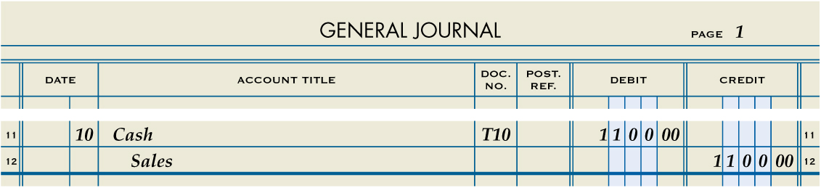
Received Cash from Sales
Lesson 3-3
LO6
Cash
January 10. Received cash from sales, $1,100.00. Calculator Tape No. 10.
1,100.00
Sales
1,100.00
1
Date
2
Debit
4
Source Document
3
Credit
1. Write the date in the Date column.
2. Write the title of the account debited in the Account Title column. Write the debit amount in the Debit column.
3. On the next line, indented about one centimeter, write the title of the account credited in the Account Title column. Write the credit amount in the Credit column.
4. Write the source document number in the Doc. No. column.

Slide 39
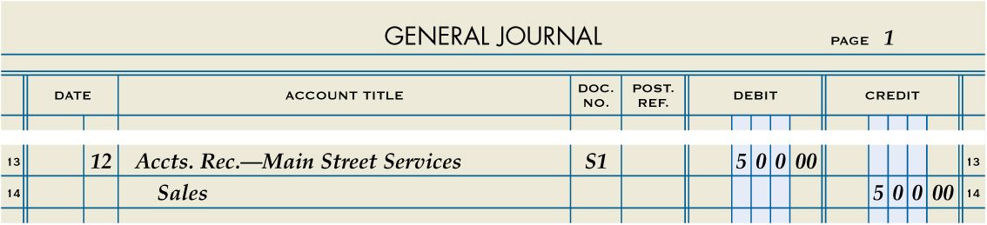
Sold Services on Account
Lesson 3-3
LO7
January 12. Sold services on account to Main Street Services, $500.00. Sales Invoice No. 1.
Accounts Rec.—Main Street Services
500.00
Sales
500.00
1
Date
2
Debit
4
Source Document
3
Credit
1. Write the date in the Date column.
2. Write the abbreviated title of the account debited in the Account Title column. Write the debit amount in the Debit column.
3. On the next line, indented about one centimeter, write the title of the account credited in the Account Title column. Write the credit amount in the Credit column.
4. Write the source document number in the Doc. No. column.

Slide 40
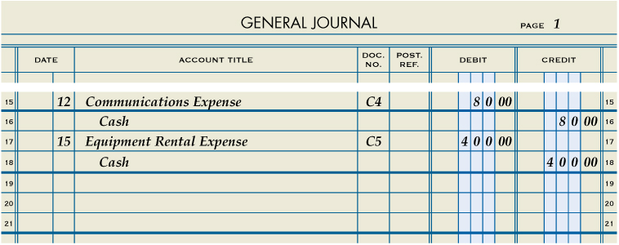
Paid Cash for an Expense
Lesson 3-3
LO7
January 12. Paid cash for communications bill including cell phone and Internet service, $80.00. Check No. 4.
Communications Expense
80.00
Cash
80.00
1
Date
2
Debit
4
Source Document
3
Credit
1. Write the date in the Date column.
2. Write the title of the account debited. Write the debit amount.
3. On the next line, write the title of the account credited. Write the credit amount.
4. Write the source document number in the Doc. No. column.

Slide 41
Paid Cash for an Expense
Lesson 3-3
LO7
January 15. Paid cash for equipment rental, $400.00. Check No. 5.
Equipment Rental Expense
400.00
Cash
400.00
1
Date
2
Debit
4
Source Document
3
Credit
1. Write the date in the Date column.
2. Write the title of the account debited. Write the debit amount.
3. On the next line, write the title of the account credited. Write the credit amount.
4. Write the source document number in the Doc. No. column.

Slide 42
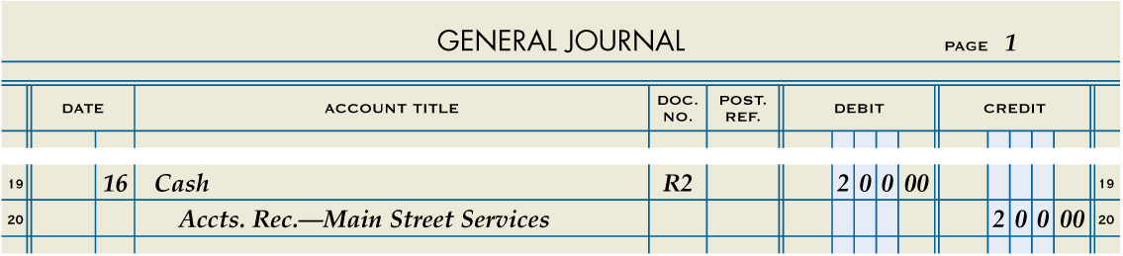
Received Cash on Account
Lesson 3-3
LO7
January 16. Received cash on account from Main Street Services, $200.00. Receipt No. 2.
Cash
200.00
Accts Rec.—Main Street Services
200.00
1
Date
2
Debit
4
Source Document
3
Credit
1. Write the date in the Date column.
2. Write the title of the account debited. Write the debit amount.
3. On the next line, indented about one centimeter, write the title of the account credited. Write the credit amount.
4. Write the source document number in the Doc. No. column.

Slide 43
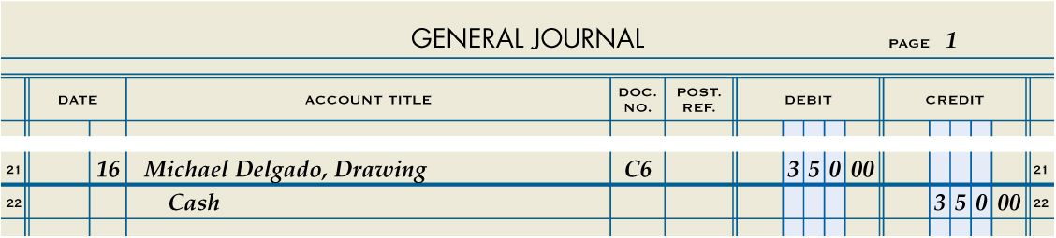
Paid Cash to Owner as Withdrawal of Equity
Lesson 3-3
LO7
January 16. Paid cash to owner for a withdrawal of equity, $350.00. Check No. 6.
Michael Delgado, Drawing
350.00
Cash
1
Date
2
Debit
350.00
4
Source Document
3
Credit
1. Write the date in the Date column.
2. Write the title of the account debited. Write the debit amount.
3. On the next line, indented about one centimeter, write the title of the account credited. Write the credit amount.
4. Write the source document number in the Doc. No. column.

Slide 44
Lesson 3-3 Audit Your Understanding
Lesson 3-3
1. When cash is received from sales, which account is listed on the first line of the entry?
ANSWER
Cash

Slide 45
Lesson 3-3 Audit Your Understanding
Lesson 3-3
2. When cash is received from sales, which account is listed on the second line of the entry?
ANSWER
Sales

Slide 46
Lesson 3-3 Audit Your Understanding
Lesson 3-3
3. When services are sold on account, which account is listed on the second line of the entry?
ANSWER
Sales

Slide 47
Lesson 3-3 Audit Your Understanding
Lesson 3-3
4. When cash is paid for any reason, what abbreviation is used for the source document?
ANSWER
C (for check)

Slide 48
Lesson 3-3 Audit Your Understanding
Lesson 3-3
5. When cash is received on account, what abbreviation is used for the source document?
ANSWER
R (for receipt)

Slide 49

Learning Objectives
LO8 Demonstrate when to end and how to start a new journal page.
LO9 Identify and correct errors using standard accounting practices.
© 2014 Cengage Learning. All Rights Reserved.

Slide 50
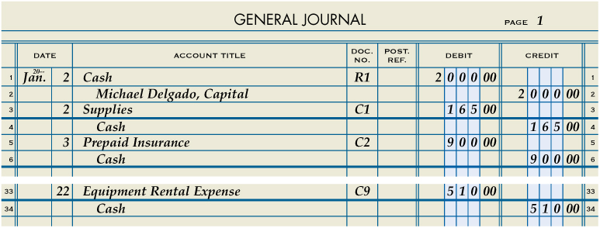
A Completed Journal Page
Lesson 3-4
LO8

Slide 51
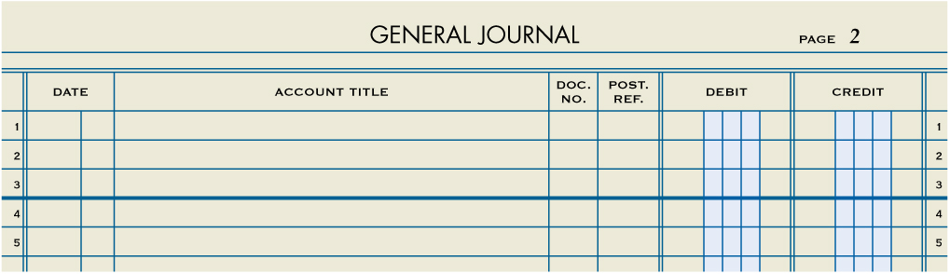
Starting a New General Journal Page
Lesson 3-4
LO8
A new page is started by writing the page number in the space provided in the journal heading.
Page number

Slide 52
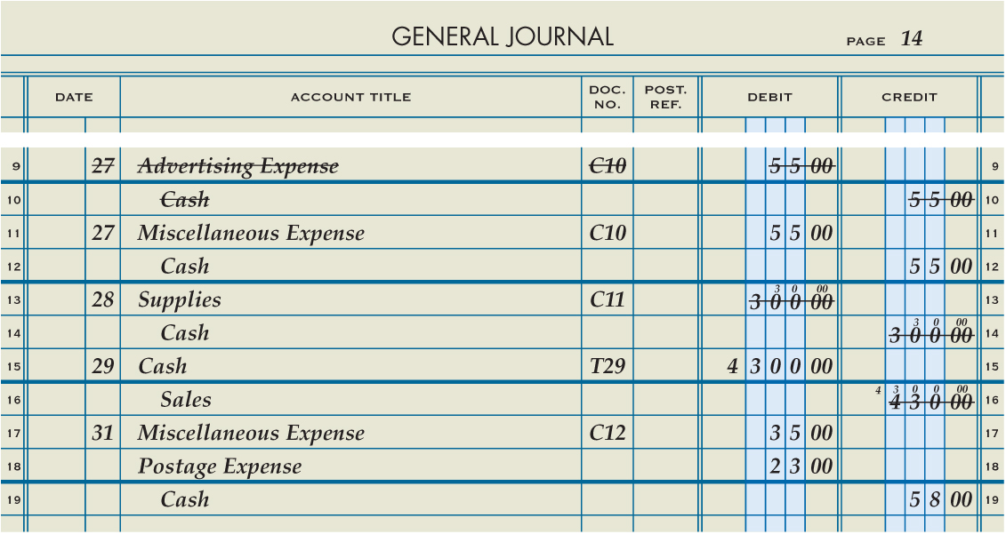
Correcting Errors in Journal Entries
Lesson 3-4
LO9
1
1. Sometimes an entire entry is incorrect and is discovered before the next entry is journalized. Draw neat lines through all parts of the incorrect entry. Journalize the entry correctly on the next blank line as shown on lines 9 through 12.

Slide 53
Correcting Errors in Journal Entries
Lesson 3-4
LO9
1
2
2. If an error is recorded, cancel the error by neatly drawing a line through the incorrect item. Write the correct item immediately above the canceled item as shown on lines 13 and 14.

Slide 54
Correcting Errors in Journal Entries
Lesson 3-4
LO9
1
2
3
3. Sometimes several correct entries are recorded after an incorrect entry is made. The next blank lines are several entries later. Draw neat lines through all incorrect parts of the entry. Record the correct items on the same lines as the incorrect items, directly above the canceled parts as shown on line 16.

Slide 55
Lesson 3-4 Audit Your Understanding
Lesson 3-4
1. When is a general journal page complete?
ANSWER
When there is insufficient space to record any more entries.

Slide 56
Lesson 3-4 Audit Your Understanding
Lesson 3-4
2. If an entire entry is incorrect and is discovered before the next entry is journalized, how should the incorrect entry be corrected?
ANSWER
Draw neat lines through all parts of the incorrect entry. Journalize the entry correctly on the next blank line.

Slide 57
Lesson 3-4 Audit Your Understanding
Lesson 3-4
3. If several correct entries are recorded after an incorrect entry is made, how should the incorrect entry be corrected?
ANSWER
Draw neat lines through all incorrect parts. Record the correct items on the same lines as the incorrect items, directly above the canceled parts.

Slide 58
work together 3-4 on your own 3-4
Continue the work together and on your own from the journals you used in 3-3.
Complete the transactions.
When finished, see your instructor so you can be assigned a partner.
Each partner will check the other partner’s ledgers for accuracy.
Discuss any differences and make any changes you feel necessary. Do not erase. Cross out and correct any errors using Standard Accounting Practices.

Slide 59
Application Problems
3-3 Application Problem
Self-Correcting Excel
3-4 Application Problem
Self-Correcting Excel – 3-4.1 - 3/29 Answer C12
Self-Correcting Excel – 3-4.2 - Dates in file do not correspond to book – complete in order and will work
3-M Mastery Problem
Excel
3-C Challenge Problem
Peachtree

Slide 60
Using Source Documents
3-S Source Documents Problem
Source Documents Problem
Journalize the transactions using the source documents listed on pages 47 – 50.
Each page is a file
Submit when completed.

